Slide 1
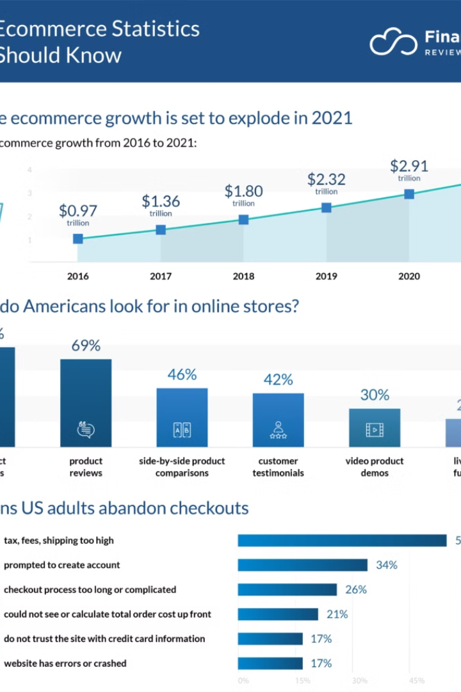

Introduction to e-Commerce sales analysis
Understanding e-Commerce sales is crucial for making informed business decisions.
by Nagesh surpurkar

Slide 2




Problem statement
Identify Issues
Evaluate Impact
Develop Solutions
Analyze challenges affecting sales performance.
Assess the effect on overall revenue and customer experience.
Plan strategies to overcome identified issues.

Slide 3
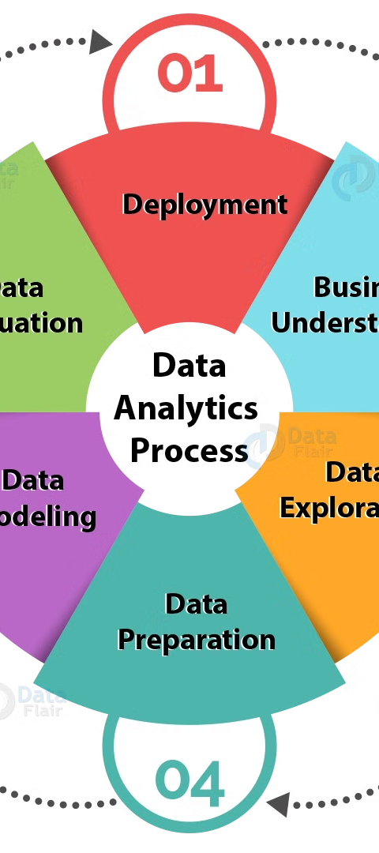
Data sources
Internal Data
External Data
Utilize transactional and customer data from the e-Commerce platform.
Include market research, industry reports, and customer feedback.

Slide 4

Methodology
1
Data Collection
2
Data Analysis
Gather relevant e-Commerce transaction and customer behavior data.
Use statistical and machine learning techniques to derive insights.
3
Visualization
Create visual representations of the data for easy interpretation.

Slide 5
Expected Outcomes
Insights
Recommendations
Reveal patterns and trends affecting sales performance.
Strategies to enhance customer engagement and retention.
Identify customer preferences and buying behaviors.
Optimization of product offerings and pricing strategy.

Slide 6



Tools and technologies using Power BI
Data Visualization
Insightful Dashboards
Data Integration
Create interactive reports and dashboards to understand trends and metrics.
Display key metrics, trends, and data visualizations for easy analysis.
Connect to various data sources for comprehensive analysis and reporting.

Slide 7

1
Risk 1
2
Risk 2
Description of Risk 1
Description of Risk 2
3
Risk 3
Description of Risk 3
1
Data Security
Ensure confidentiality and protection of sensitive business data.
2
Data Quality
Address inaccuracies and inconsistencies in the collected data.
3
Technological Limitations
Overcome constraints in handling and processing large volumes of data.

Slide 8
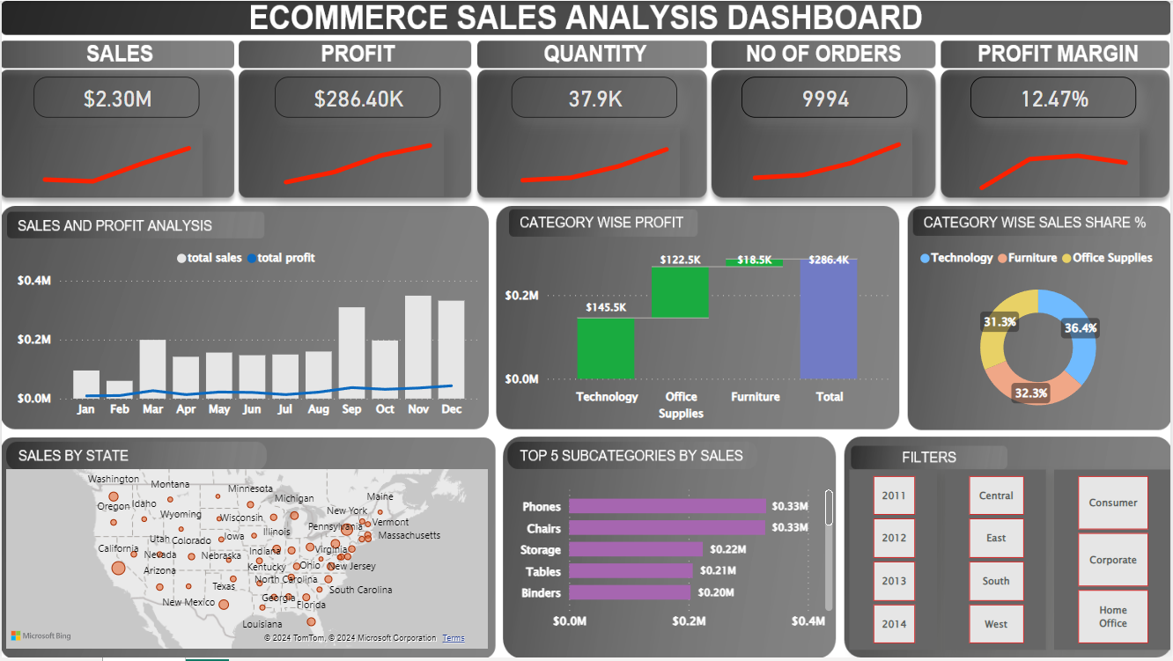
2
Risk 2
Description of Risk 2
Risk 3
Data Security
Ensure confidentiality and protection of sensitive business data.
2
Data Quality
Address inaccuracies and inconsistencies in the collected data.
A dashboard that is been created after analysis of the data, where we can interpret Sales, Profit, Quantity,
No of Orders and Profit Margin
We can also Interpret the Graphs according to the different attributes against Sales

Slide 9
Conclusion and recommendations for optimizing e-Commerce sales performance
3
2
4
Data-Driven Strategies
User Experience
Continuous Monitoring
Utilize analytical insights to drive targeted marketing and sales tactics.
Enhance the e-Commerce platform to improve customer satisfaction and loyalty.
Regularly evaluate performance metrics and adjust strategies accordingly.

